Slide 1

Algorithms and Data Structures 1 CS 0445
Fall 2023
Java Review – Part 2
Sherif Khattab
ksm73@pitt.edu
(Slides are adapted from Dr. Ramirez’s and Dr. Farnan’s CS1501 slides.)

Slide 2
Announcements
Recitations start this week
Homework 1 due tonight
Unlimited submissions with no feedback until the deadline
Tophat excuses policy
Five grace tokens Please send a Piazza message to Grader TA

Slide 3
Today’s Agenda
Java Review Theme:
Tools for writing library code
Polymorphism
Encapsulation and Abstraction
Abstract Classes
Java Interfaces
Java Generics

Slide 4
Polymorphism
A reference variable can be used to point to objects of the same or derived types
Upon calling a method, Java runtime will reference the correct method at runtime
Example:
public static void display(Square s){
System.out.println(s.toString());
}
Square s = new Square();
display(s) ;
Square.toString() will be called
Square s = new ColoredSquare();
display(s);
ColoredSquare.toString() will be called
Check Main.java under InheritanceExample

Slide 5
Multiple Inheritance
Some programming languages allow one class to be derived from two different super classes
This feature is not allowed in Java
In Java, a subclass can have only one superclass
Java Interfaces allow for multiple inheritance

Slide 6
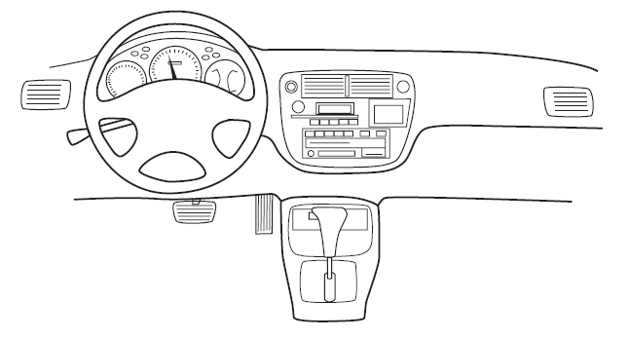
Encapsulation
Enclose data and methods within a class
Hide implementation details
Programmer receives only enough information to be able to use the class
An automobile’s controls are visible to the driver, but its inner workings are hidden

Slide 7
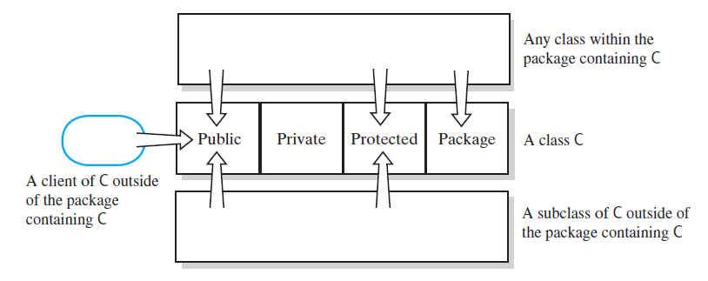
Access Modifiers
Public, private, protected, and package access of the data fields and methods of class C

Slide 8
Abstraction using Abstract Classes
One way of exposing the outside behavior is by using abstract classes
An abstract class has one or more abstract methods
Declare abstract method by including reserved word abstract in header
Implementation of an abstract method is elsewhere
One cannot instantiate objects from abstract classes
why?
Can define classes that are subclasses of an abstract class

Slide 9
Abstract Classes and Methods
Abstract method cannot be private, static, or final
why?
Class with at least one abstract method must be declared as an abstract class
Abstract methods can appear only within an abstract class.
Constructors cannot be abstract

Slide 10
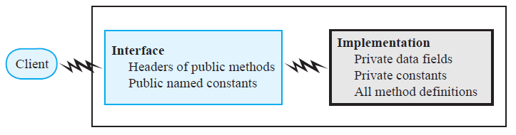
Abstraction using Interfaces
Focus on what instead of how
What needs to be done?
For the moment ignore how it will be done.
Divide class into two parts
Interface
provides well-regulated communication between a hidden implementation and a client
Implementation

Slide 11
Java Interfaces
Program component that declares one or more public methods
Should include comments to inform programmer
Any data fields here should be public, final, static
May have default methods

Slide 12
Method Documentation in Interfaces
Preconditions
What must be true before method executes
Usually about method parameters
Implies responsibility for client
Postconditions
Statement of what is true after method executes
Usually about the return value(s)
Assertions
Describe invariants inside comments
Also, with assert statements inside code

Slide 13
Implementing an Interface
Several classes can implement the same interface
A class can implement more than one interface
A form of multiple inheritance
Otherwise, multiple inheritance is not allowed in Java
Illegal to say class A extends B, C

Slide 14
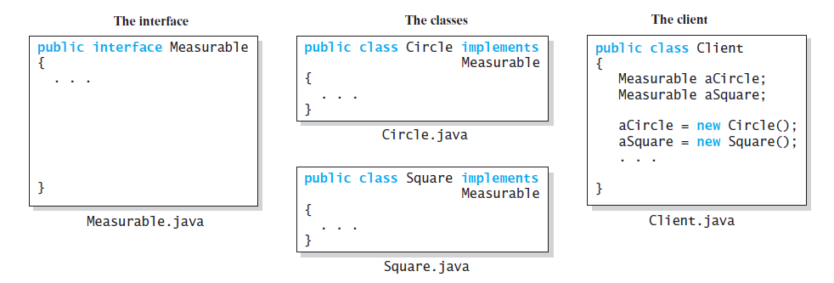
Interface vs. Implementation vs. Client
an interface, two implementations, and a client

Slide 15
Interface as a Data Type
Java interfaces are data types
A reference variable of an interface typcan invoke a certain set of methods and only those methods
An interface type is a reference type
An interface can be used to derive another interface by using inheritance

Slide 16
Interface vs. Abstract Class
Purpose of interface similar to that of abstract class
But an interface is not a class
A class can implement several interfaces but can extend only one abstract class

Slide 17
Today’s Agenda
Java Review Theme:
Tools for writing library code
Polymorphism
Encapsulation and Abstraction
Java Interfaces
Java Generics
Exceptions
Copying objects
Shallow, deep, and deeper copying
File Operations

Slide 18
Generic Data Types
Enable you to write a placeholder for a type instead of an actual class type
The placeholder is called a type parameter
Generic class: a class with one or more type parameters
Example: class representing a collection of data items
Client chooses data type of the objects in collection using angle brackets
e.g., Bag<Integer> myBag;
Interfaces can be generic as well

Slide 19
Generic Data Types
public final class ArrayBag<T> { … }
T is a formal type parameter
ArrayBag<Square> declares a reference variable of the generic type ArrayBag<T>
ArrayBag<Square> is a parameterized type
Square is the actual type parameter
Generic data types, like any other class, may extend another class (generic or not) and/or implement interface(s) (generic or not)

Slide 20
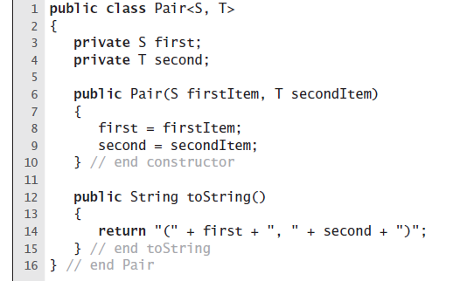
Example: Two Type Parameters

Slide 21
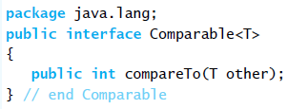
Generic Interface Comparable
By invoking compareTo, you compare two objects of type T
compareTo returns:
Negative: this < other
Zero: if this.equals(other)
Positive: if this > other

